Slide 1
ARE YOU READY FOR OUR REVEAL...?

Slide 2


GRAND INVESTOR’S MEET
VENUE : IIT MADRAS
cardiocare@gmail.com

Slide 3





Our Team
OFFERING BEST SERVICES FOR HEART FROM HEART
Dinesh Kumar M
Harish Sridhar
Keshav Mishra
Chief Executive Officer
Chief Operating Officer
Chief Technology Officer

Slide 4
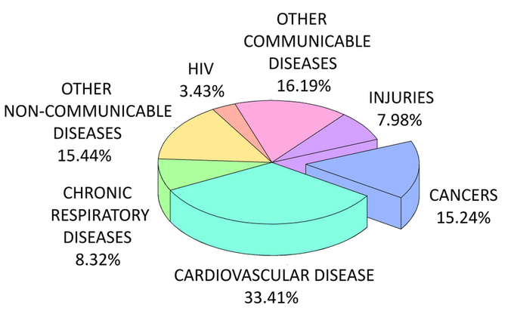
Why do the World Needs Cardiocare ?
Cardiovascular diseases (CVDs) are the leading cause of death globally, taking an estimated 17.9 million lives each year. One third of these deaths occur prematurely in people under 70 years of age
CONTINOUS MONITORING
EARLY DETECTION AND DIAGNOSIS
EMERGENCY
CARE
Integration of Wearables
Easy to access:
Accurate and reliable evaluation
Advanced diagnostic services
24/7 emergency services
Urgent medical care through IoT
01
02
03
Source : who.int/health-topics/cardiovascular-diseases

Slide 5
OUR PROPOSAL
CARDIOVASCULAR MONITORING USING PHOTOPLETYSMOGRAPHY
Why PPG?
Non-invasiveness
Cost-effectiveness
Wearability:
Multiple Measurements
Ease of Use

Slide 6
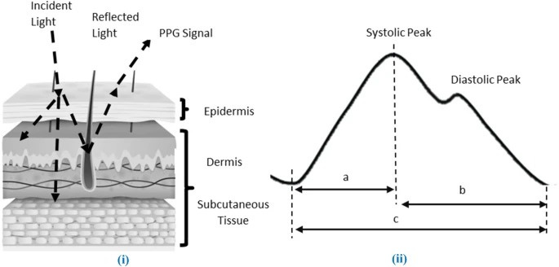
PHOTOPLETYSMOGRAPHY
Source: link.springer.com/article/10.1007/s13246-021-01072-5

Slide 7
OBJECTIVE
ACQUISITION OF PPG SIGNAL
SIGNAL PROCESSING
PARAMETER ESTIMATION

Slide 8
ACQUISTION OF PPG SIGNAL
DESIGN CONSIDERATION
.
How to choose an emitter with a specific frequency
What Should be the interspacing distance between Emitter and Detector
Source and Origin of noises

Slide 9
How to choose emitter on the basis of frequency ?
How to choose emitter with what frequency
Possible Candidates
Red (600-750nm)
Green (around 525 nm)
IR (800-1000nm)
Since the blood looks red, this means it absorbs all the other colors except red and scatters red the most. This makes it a good color to select.
Also the emitter is selected based on the sensitivity of the detector and the placement of sensing.

Slide 10
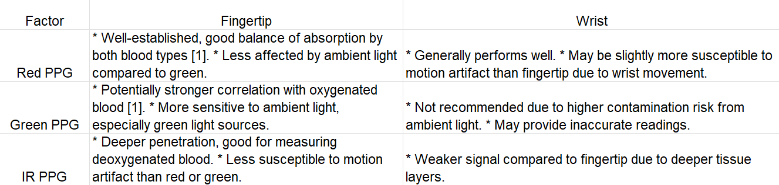
Red or Green or IR ?
Sensing area for our product : Wrist
References
[1 ] Comparison of Reflected Green Light and Infrared Photoplethysmography (2018) by Wu, M., et al.
[2] Effective PPG sensor placement for reflected red and green light, and infrared wristband-type photoplethysmography (2016) by S. Sun et al.

Slide 11
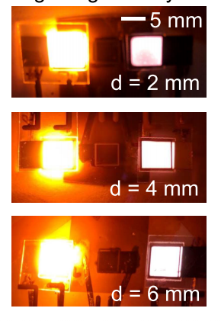
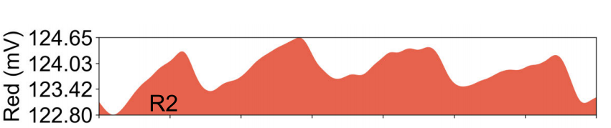
What Should be the interspacing distance between Emitter and Detector
We were facing a difficulty while acquiring ppg signal with the preferred emitter and photodetector.
We started to brainstorm and found the significance of interspacing distance by citing the Reference [1] and [2]
Time(s)
References
[1 ] Y. Khan, D. Han, J. Ting, M. Ahmed, R. Nagisetty and A. C. Arias, "Organic Multi-Channel Optoelectronic Sensors for Wearable Health Monitoring," in IEEE Access, vol. 7, pp. 128114-128124, 2019, doi: 10.1109/ACCESS.2019.2939798.
[2] M Hickey and P A Kyriacou 2007, “Optimal spacing between transmitting and
receiving optical fibres in reflectance pulse oximetry “, J. Phys.: Conf. Ser. 85 012030, IEEE, 2019, doi: 10.1109/ACCESS.2019.2939798

Slide 12
Source and Origin of noises
1) The raw ppg signal after aquisition has to be carefully amplified and filtered since it is heavily affected by environmental noises. The raw PPG signal has a low amplitude level, on the order of 4 mV-6 mV. Tthe frequency content of a generic PPG signal has a range between 0.2 Hz and 6 Hz [1]
SOLUTION :
The signal is amplified only in the useful bandwidth (0.2 Hz and 6 Hz).
The filtering stage is formed by a passive high filter followed by an active low filter.
lower cut-off frequency of 0.2 Hz and an upper cut-off frequency of 4.1 Hz.
The gain is on the order of 33.73 dB.
2) Ambient light noise will be minimal as we didn’t use Green light source asemitter
References
[1 ] C. M. De Dominicis, D. Mazzotti, M. Piccinelli, S. Rinaldi, A. Vezzoli and A. Depari, "Evaluation of Bluetooth Hands-Free profile for sensors applications in smartphone platforms," 2012 IEEE Sensors Applications Symposium Proceedings, Brescia, Italy, 2012, pp. 1-6, doi: 10.1109/SAS.2012.6166305.

Slide 13
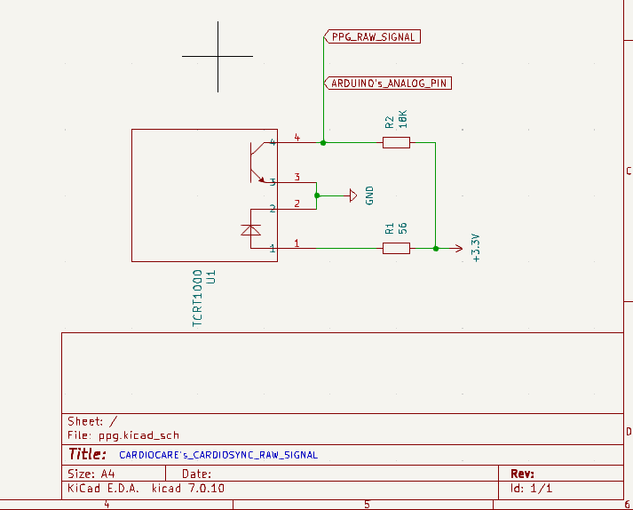
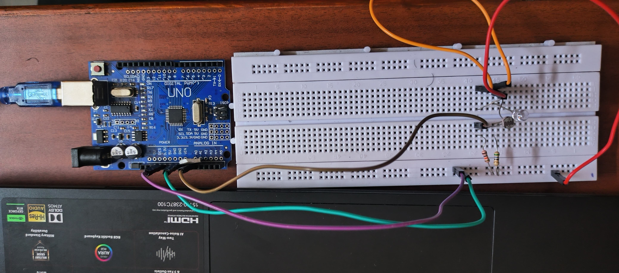
Raw Signal

Slide 14
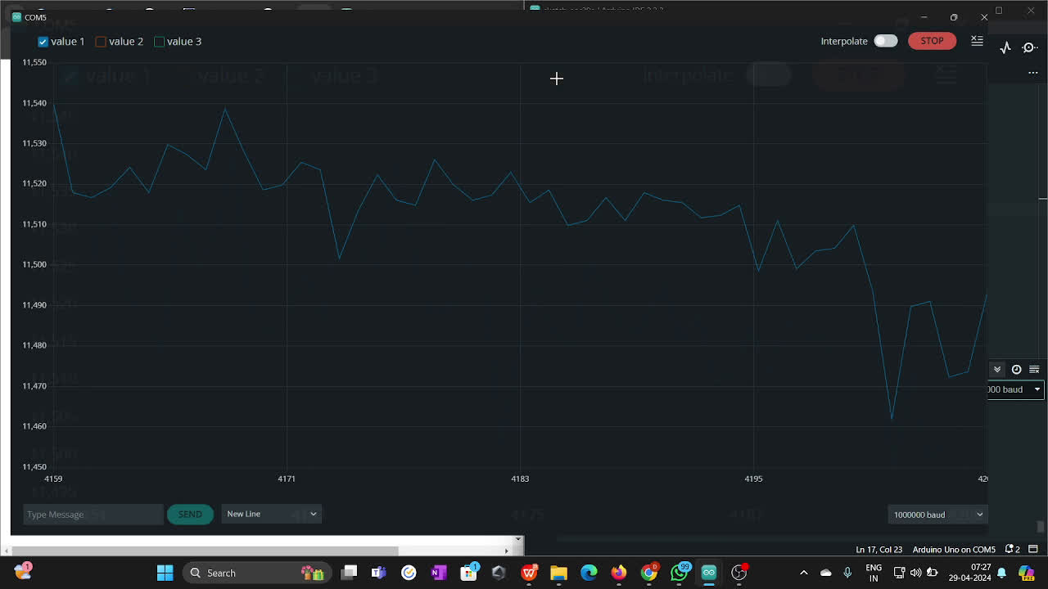
Raw PPG - Output
Specification:
Red LED of 640 nm, diameter of 5mm
Photodetector : ADS 9008 (chosen based on sensitivity - Peak sensitivity wavelength 670nm)
Microcontroller : Arduino Uno

Slide 15
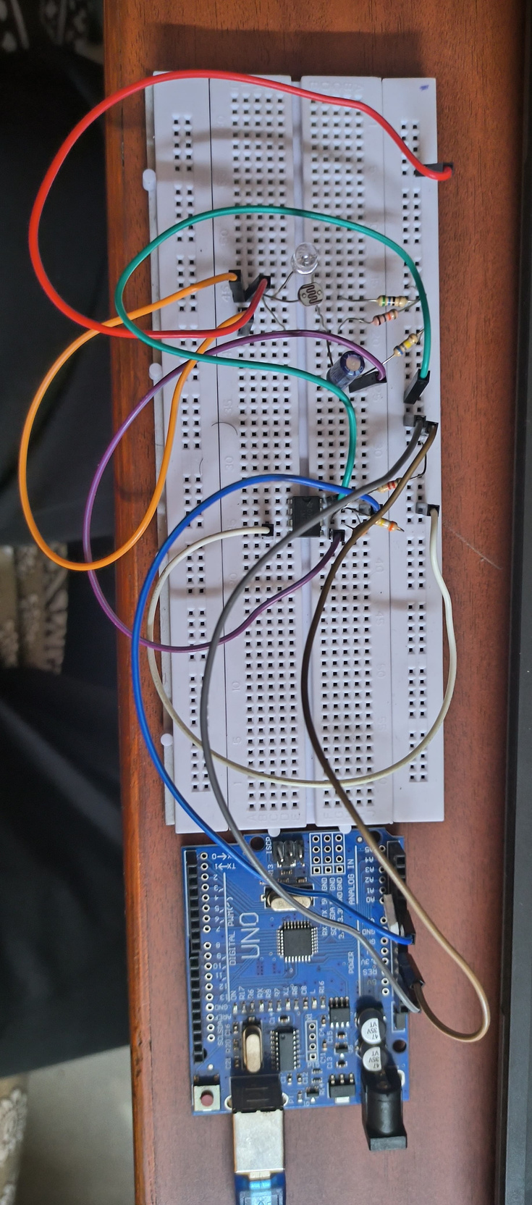
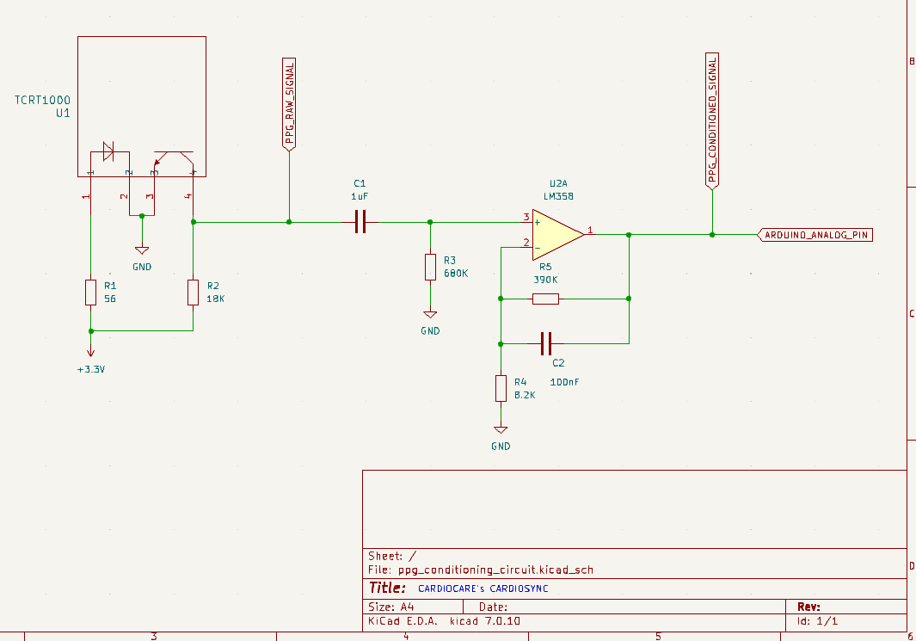
Amplification and Filtering circuit

Slide 16
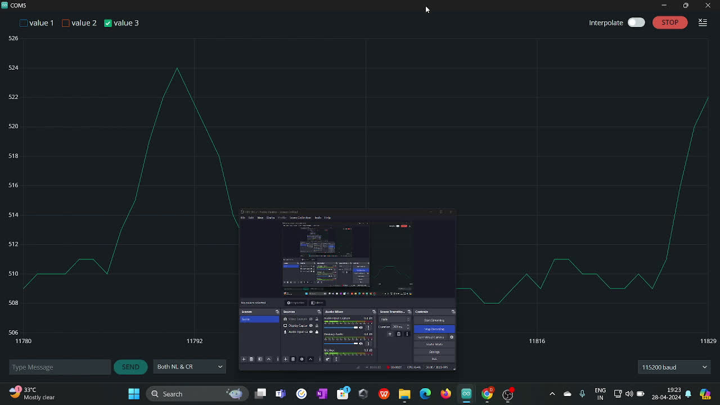
Filtered and Amplified PPG- Output
Specification:
A passive high filter followed by an active low filter
Lower cut-off frequency of 0.2 Hz and an upper cut-off frequency of 4.1 Hz
OP-AMP : LM358 , GAIN : 33.73 dB.

Slide 17
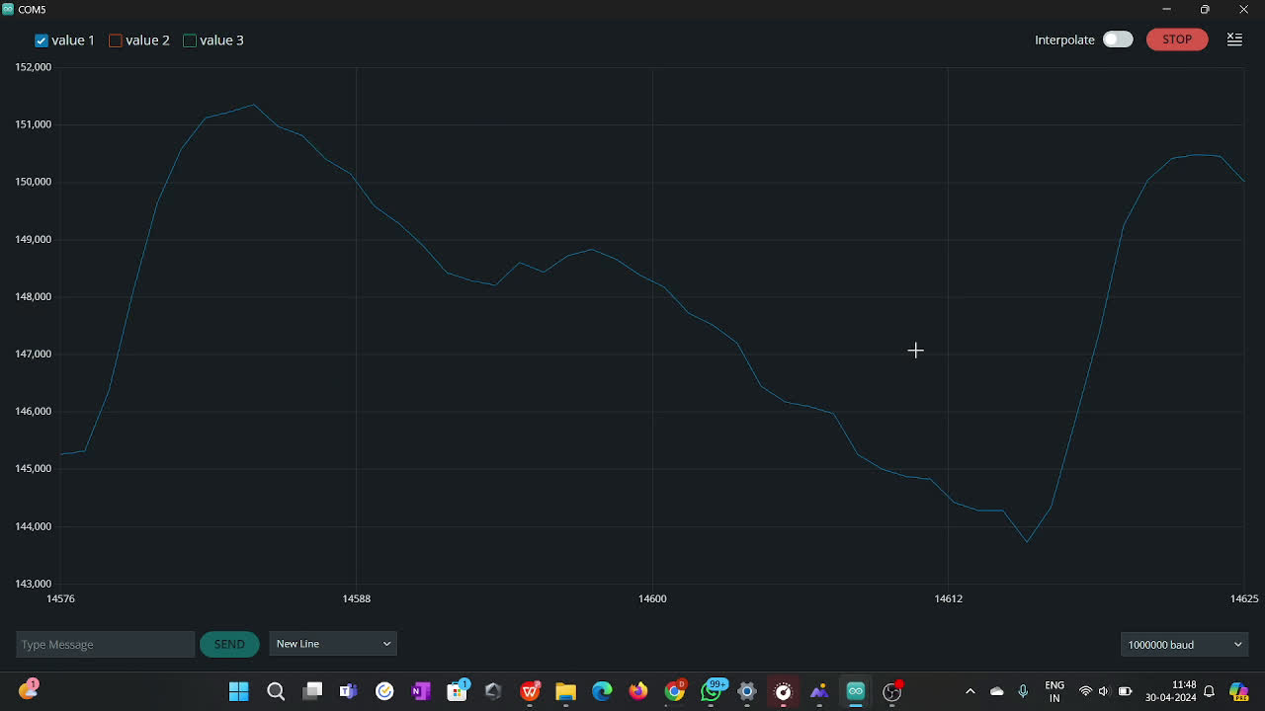
INTERSPACING DISTANCE - Output
INTERSPACING DISTANCE - 6mm

Slide 18
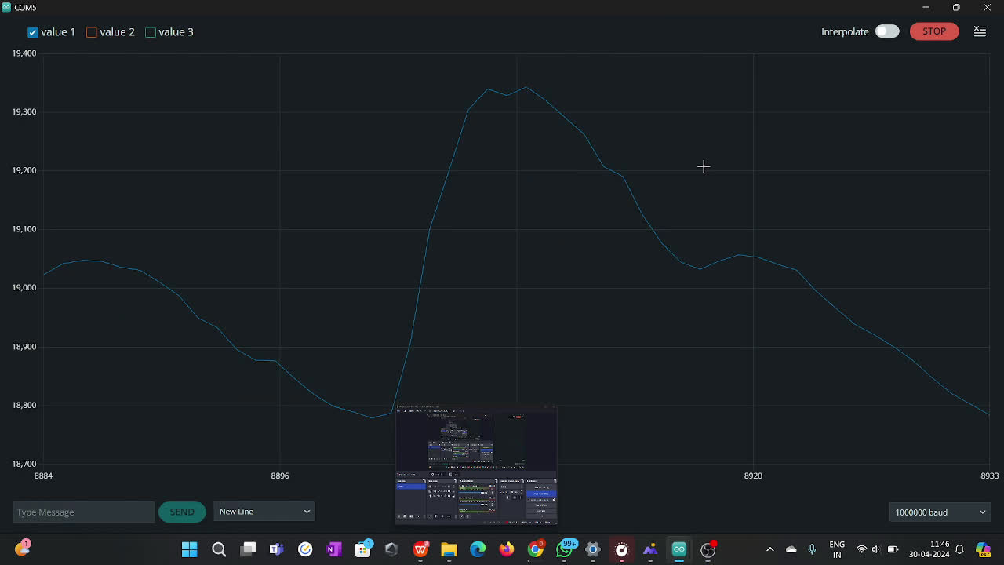
INTERSPACING DISTANCE - Output
INTERSPACING DISTANCE - 4mm

Slide 19
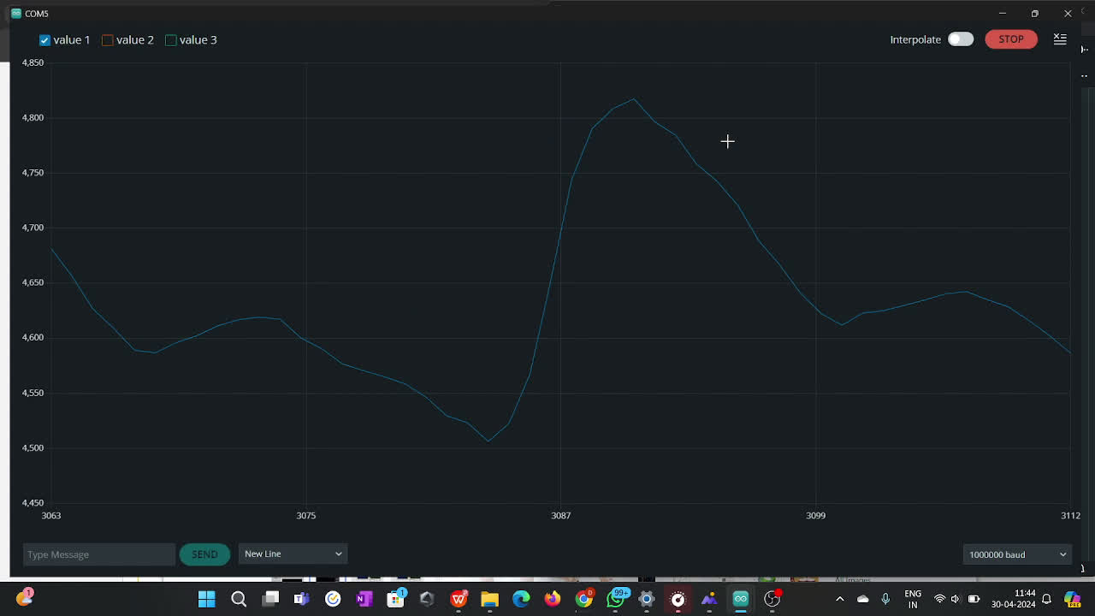
INTERSPACING DISTANCE - Output
INTERSPACING DISTANCE - 2mm

Slide 20
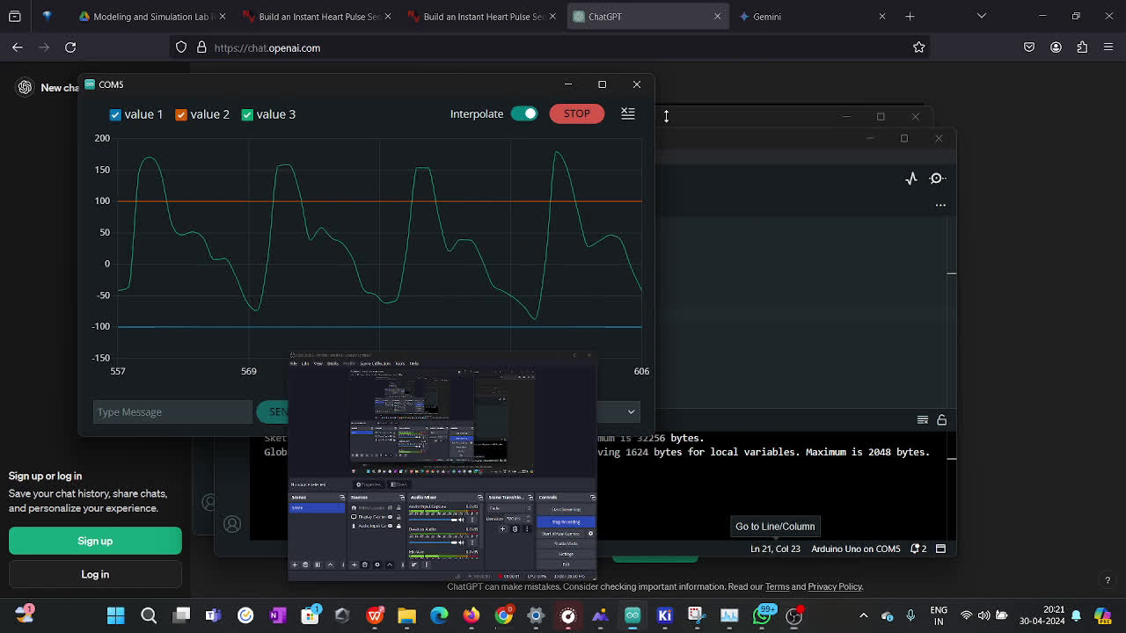
AMBIENT NOISE REMOVAL - Output
MOVING AVERAGE FILTER (DIGITAL)

Slide 21
FURTHER PROCEEDINGS - OUTCOME
SIGNAL CONDITIONED PPG SIGNAL
.
Recorded the signal for approximately 7 - 8minutes
saved as csv file for further parameter estimation and fed to labview

Slide 22

PARAMETERES ESTIMATED
Heart rate
Respiratory Rate
Pulse Rate Variability

Slide 23
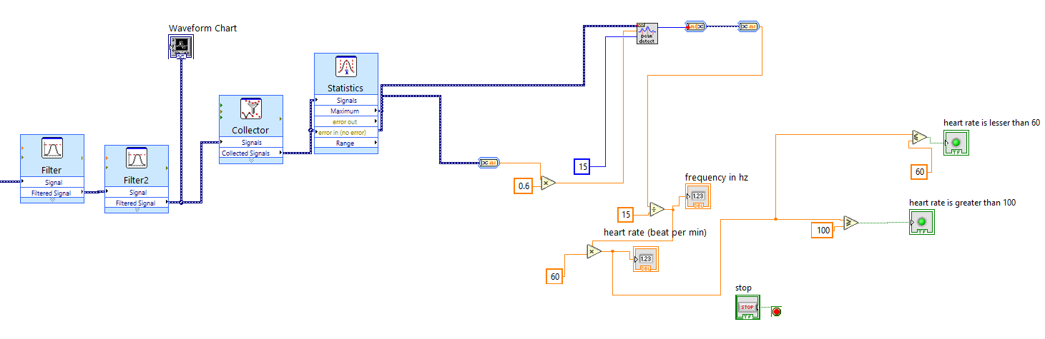

Slide 24
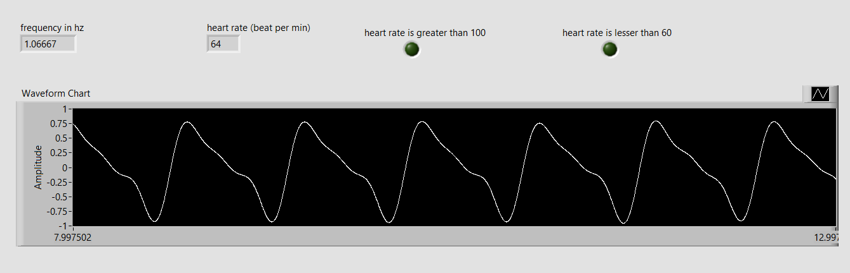

Slide 25
Here's a list of common heart rate abnormalities:
1. Tachycardia: This refers to a heart rate that is too fast, generally exceeding 100 beats per minute (bpm).
HEART RATE
HR is measured as the pulse rate (PR)—the rate of pulse waves detected in the PPG.
.
Here's a list of common heart rate abnormalities:
1. Tachycardia: This refers to a heart rate that is too fast, generally exceeding 100 beats per minute (bpm).
2. Bradycardia: This signifies a heart rate that is too slow, typically below 60 bpm.

Slide 26
RESPIRATORY RATE
Respiratory rate refers to the number of breaths a person takes per minute. It's a vital sign that can indicate various underlying health conditions when abnormal.
Types of Respiratory Rate Abnormalities:
Tachypnea: This refers to an abnormally fast breathing rate ( >25 Breaths per minute), typically exceeding the normal range for a specific age group.
Bradypnea: This signifies a slow breathing rate, typically falling below 12 breaths per minute in adults.
Apnea: This refers to the complete absence of breathing for a period of time, often associated with sleep apnea..
Hyperpnea: This describes rapid and deep breathing, often seen in cases of respiratory distress or metabolic imbalances.
.

Slide 27
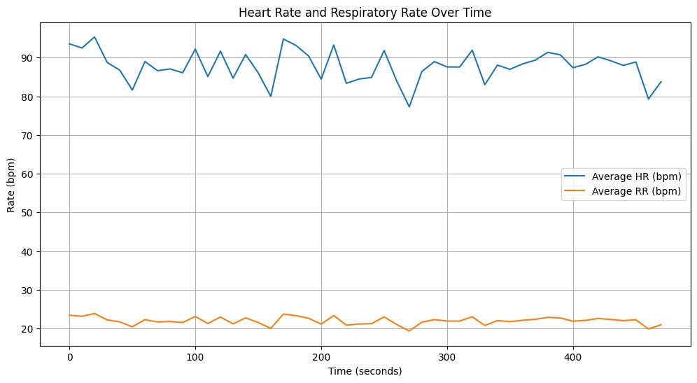
HEART AND RESPIRATORY RATE

Slide 28
PULSE RATE VARIABILITY
Pulse Rate Variability is the variability of Inter-Beat Intervals derived from a pulse wave signal. Measures the variations in the intervals between pulse peaks detected through photoplethysmography (PPG) sensors.
Reduced PRV can cause:
Stress and Anxiety
Heart problems affecting Autonomic Nervous Function
..

Slide 29
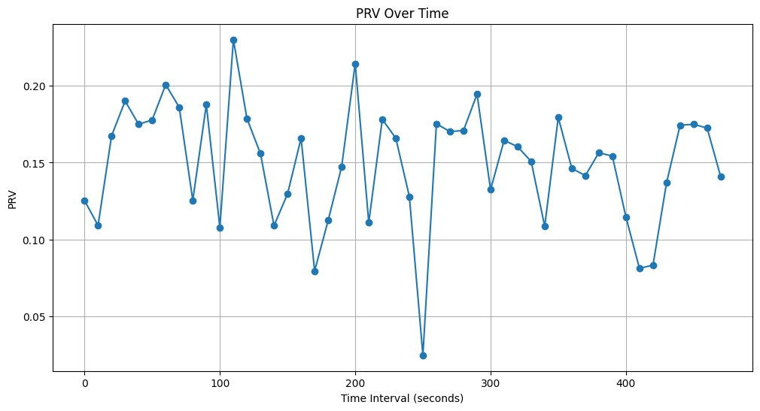
PULSE RATE VARIABILITY

Slide 30

FUTURE WORKS
POSSIBLE OTHER DIAGNOSIS AND ESTIMATES
Atrial Fibrillation
Blood Pressure
Obstructive sleep apnea
Mental Stress Monitoring
Preclampsia
Vascular Age

Slide 31
OBJECTIVES MET ?
ACQUISITION OF PPG SIGNAL
SIGNAL PROCESSING
PARAMETER ESTIMATION
???????????

Slide 32
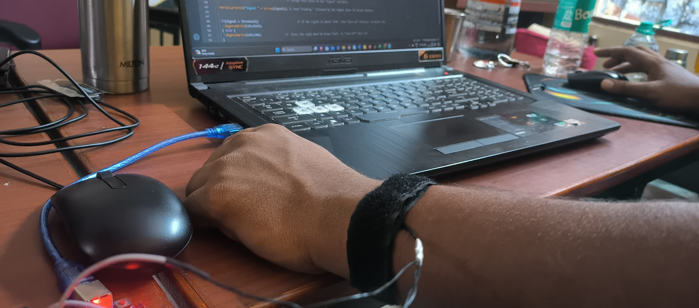
We have come this far!!!!!

Slide 33

WE WANT THIS TO BE OUR DEBUT PRODUCT
POSSIBLY IN 2027!!!

Slide 34




REACH US FOR COLLABORATION AND JOB OPPURTUNITIES
cardiocare@gmail.com
cardiocare@gmail.com
9962367035
Chennai, Tamil Nadu, India

